Slide 1


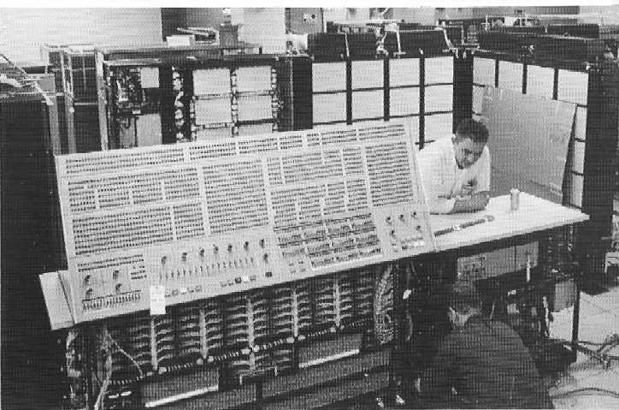
CISC360 Computer Architecture
Lesson 2
Computer Function and Interconnection (System Busses)

Slide 2

Program Concept
Hardwired systems are inflexible
General purpose hardware can do different tasks, given correct control signals
Instead of re-wiring, supply a new set of control signals

Slide 3
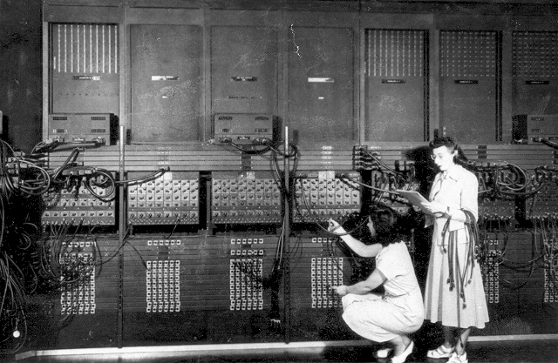
Hard-wired Programming

Slide 4
What is a program?
A sequence of steps
For each step, an arithmetic or logical operation is done
For each operation, a different set of control signals is needed

Slide 5
Function of Control Unit
For each operation a unique code is provided
  e.g. ADD, MOVE
A hardware segment accepts the code and issues the control signals
We have a computer!

Slide 6
Components
The Control Unit and the Arithmetic and Logic Unit constitute the Central Processing Unit
Data and instructions need to get into the system and results out
  Input/output
Temporary storage of code and results is needed
  Main memory

Slide 7
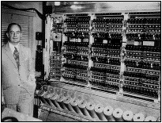
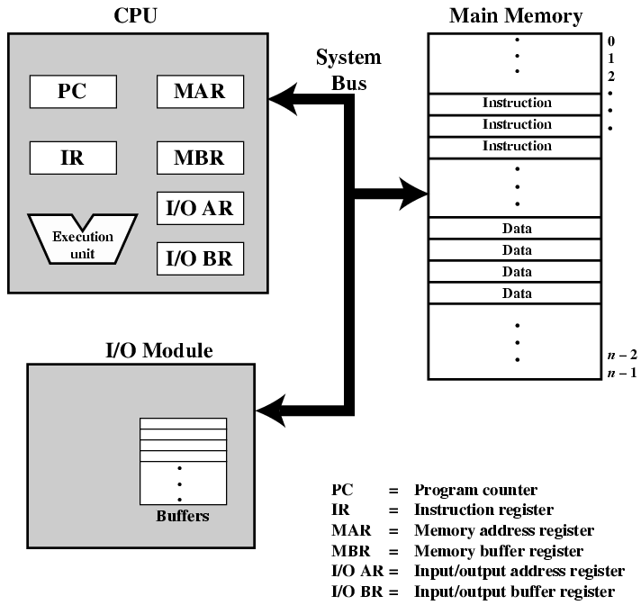
Computer Components:
Top Level View

Slide 8

Instruction Cycle
Two steps:
  Fetch
  Execute

Slide 9
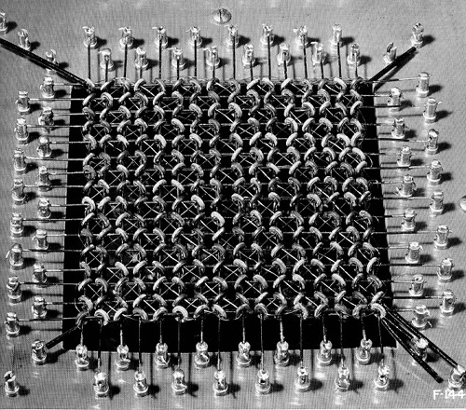
Fetch Cycle
Program Counter (PC) holds address of next instruction to fetch
Processor fetches instruction from memory location pointed to by PC
Increment PC
  Unless told otherwise
Instruction loaded into Instruction Register (IR)
Processor interprets instruction and performs required actions

Slide 10
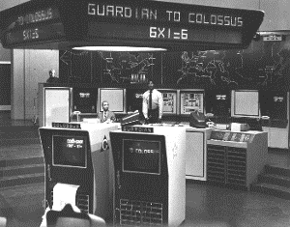
Execute Cycle
Processor-memory
  data transfer between CPU and main memory
Processor I/O
  Data transfer between CPU and I/O module
Data processing
  Some arithmetic or logical operation on data
Control
  Alteration of sequence of operations
  e.g. jump
Combination of above

Slide 11
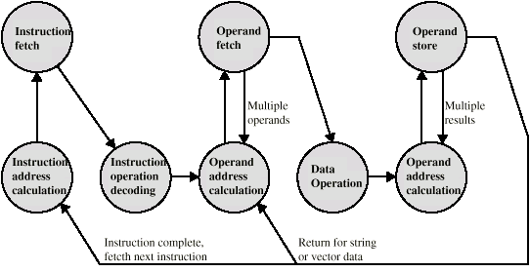
Instruction Cycle -
State Diagram

Slide 12
Interrupts
Mechanism by which other modules (e.g. I/O) may interrupt normal sequence of processing
Program
  e.g. overflow, division by zero
Timer
  Generated by internal processor timer
  Used in pre-emptive multi-tasking
I/O
  from I/O controller
Hardware failure
  e.g. memory parity error

Slide 13
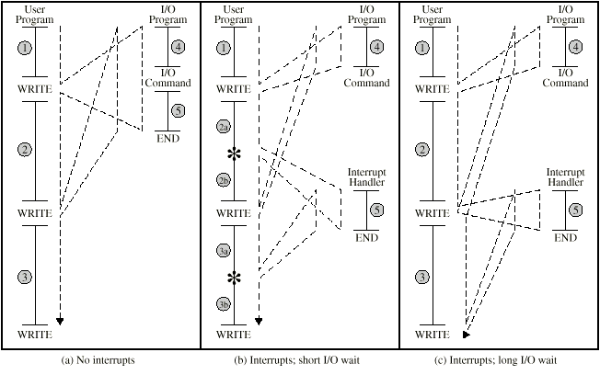
Program Flow Control

Slide 14
Interrupt Cycle
Added to instruction cycle
Processor checks for interrupt
  Indicated by an interrupt signal
If no interrupt, fetch next instruction
If interrupt pending:
  Suspend execution of current program
  Save context
  Set PC to start address of interrupt handler routine
  Process interrupt
  Restore context and continue interrupted program

Slide 15
Problem
What does “save context” mean? WHAT constitutes “context”? WHERE do we save it? WHAT are the performance implications?
Take 5 minutes to discuss in your group and be prepared with some answers!

Slide 16

Transfer of Control via Interrupts

Slide 17

Instruction Cycle with Interrupts

Slide 18
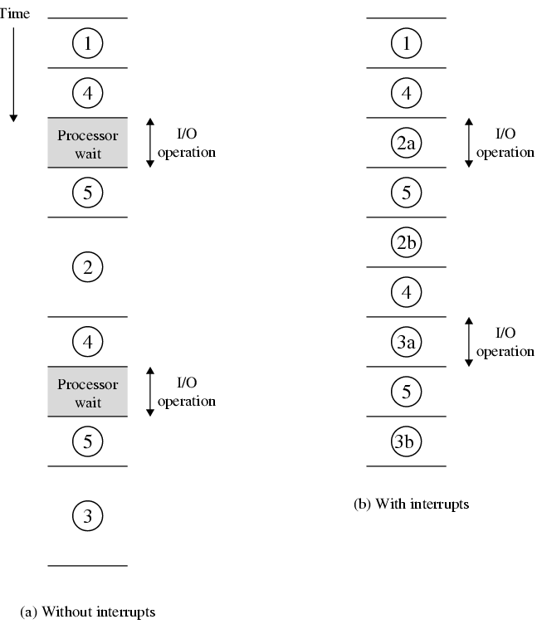
Program Timing
Short I/O Wait

Slide 19
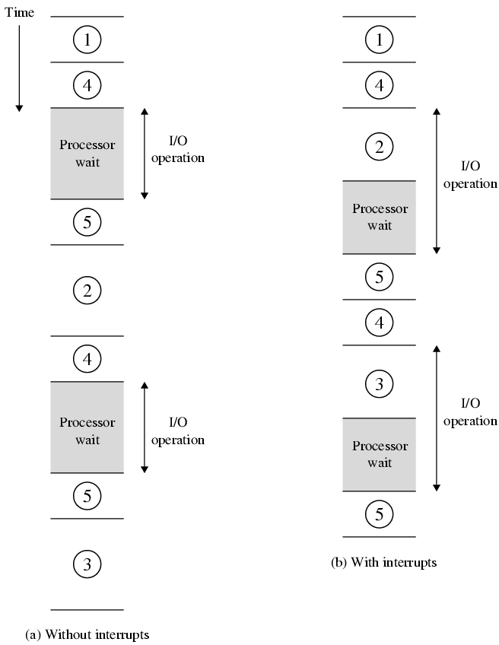
Program Timing
Long I/O Wait

Slide 20
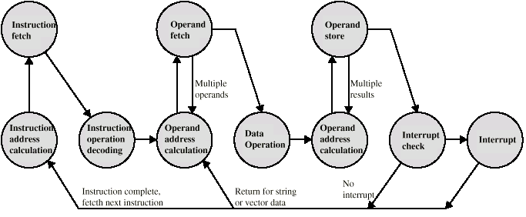
Instruction Cycle (with Interrupts) - State Diagram

Slide 21
Multiple Interrupts
Disable interrupts
  Processor will ignore further interrupts whilst processing one interrupt
  Interrupts remain pending and are checked after first interrupt has been processed
  Interrupts handled in sequence as they occur
Define priorities
  Low priority interrupts can be interrupted by higher priority interrupts
  When higher priority interrupt has been processed, processor returns to previous interrupt

Slide 22

Multiple Interrupts - Sequential

Slide 23
Multiple Interrupts – Nested

Slide 24

Time Sequence of Multiple Interrupts

Slide 25
Connecting
All the units must be connected
Different type of connection for different type of unit
  Memory
  Input/Output
  CPU

Slide 26

Computer Modules

Slide 27
Memory Connection
Receives and sends data
Receives addresses (of locations)
Receives control signals
  Read
  Write
  Timing

Slide 28
Input/Output Connection(1)
Similar to memory from computer’s viewpoint
Output
  Receive data from computer
  Send data to peripheral
Input
  Receive data from peripheral
  Send data to computer

Slide 29
Input/Output Connection(2)
Receive control signals from computer
Send control signals to peripherals
  e.g. spin disk
Receive addresses from computer
  e.g. port number to identify peripheral
Send interrupt signals (control)

Slide 30
CPU Connection
Reads instruction and data
Writes out data (after processing)
Sends control signals to other units
Receives (& acts on) interrupts

Slide 31
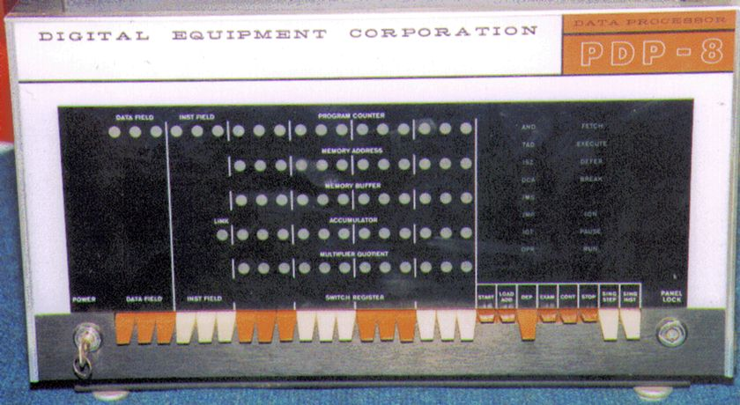
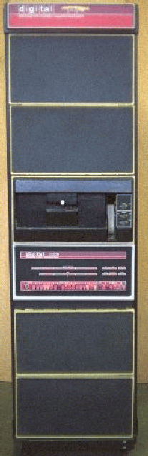
Buses
There are a number of possible interconnection systems
Single and multiple BUS structures are most common
e.g. Control/Address/Data bus (PC)
e.g. Unibus (DEC-PDP)

Slide 32
What is a Bus?
A communication pathway connecting two or more devices
Usually broadcast
Often grouped
  A number of channels in one bus
  e.g. 32 bit data bus is 32 separate single bit channels
Power lines may not be shown

Slide 33
Data Bus
Carries data
  Remember that there is no difference between “data” and “instruction” at this level
Width is a key determinant of performance
  8, 16, 32, 64 bit
  WHAT are the other determinants?

Slide 34
Address bus
Identify the source or destination of data
e.g. CPU needs to read an instruction (data) from a given location in memory
Bus width determines maximum memory capacity of system
  e.g. 8080 has 16 bit address bus giving 64k address space
  Why is this true? What are the alternatives?

Slide 35
Control Bus
Control and timing information
  Memory read/write signal
  Interrupt request
  Clock signals

Slide 36

Bus Interconnection Scheme

Slide 37
Big and Yellow?
What do buses look like?
  Parallel lines on circuit boards
  Ribbon cables
  Strip connectors on mother boards
    e.g. PCI
  Sets of wires

Slide 38
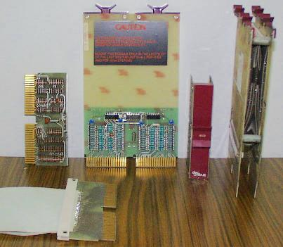
UNIBUS Cable and terminators

Slide 39
Single Bus Problems
Lots of devices on one bus leads to:
  Propagation delays
    Long data paths mean that co-ordination of bus use can adversely affect performance
    If aggregate data transfer approaches bus capacity
Most systems use multiple buses to overcome these problems

Slide 40
Thought Problem
Let’s apply the DuPont Engineer’s philosophy, “if a little bit is good, a lot more is a lot better” to bus widths.
What limits the width of system busses?

Slide 41

Traditional (ISA)
(with cache)

Slide 42
High Performance Bus

Slide 43
Bus Types
Dedicated
  Separate data & address lines
Multiplexed
  Shared lines
  Address valid or data valid control line
  Advantage - fewer lines
  Disadvantages
    More complex control
    Ultimate performance

Slide 44
Bus Arbitration
More than one module controlling the bus
e.g. CPU and DMA controller
Only one module may control bus at one time
Arbitration may be centralised or distributed

Slide 45
Centralised Arbitration
Single hardware device controlling bus access
  Bus Controller
  Arbiter
May be part of CPU or separate

Slide 46
Distributed Arbitration
Each module may claim the bus
Control logic on all modules

Slide 47
Timing
Co-ordination of events on bus
Synchronous
  Events determined by clock signals
  Control Bus includes clock line
  A single 1-0 is a bus cycle
  All devices can read clock line
  Usually sync on leading edge
  Usually a single cycle for an event

Slide 48
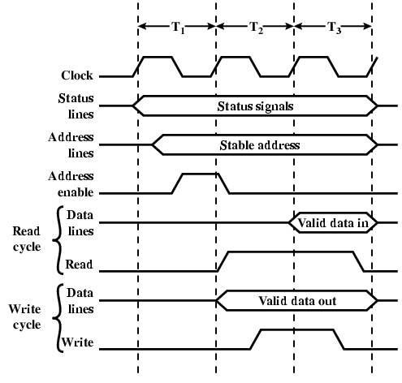
Synchronous Timing Diagram

Slide 49
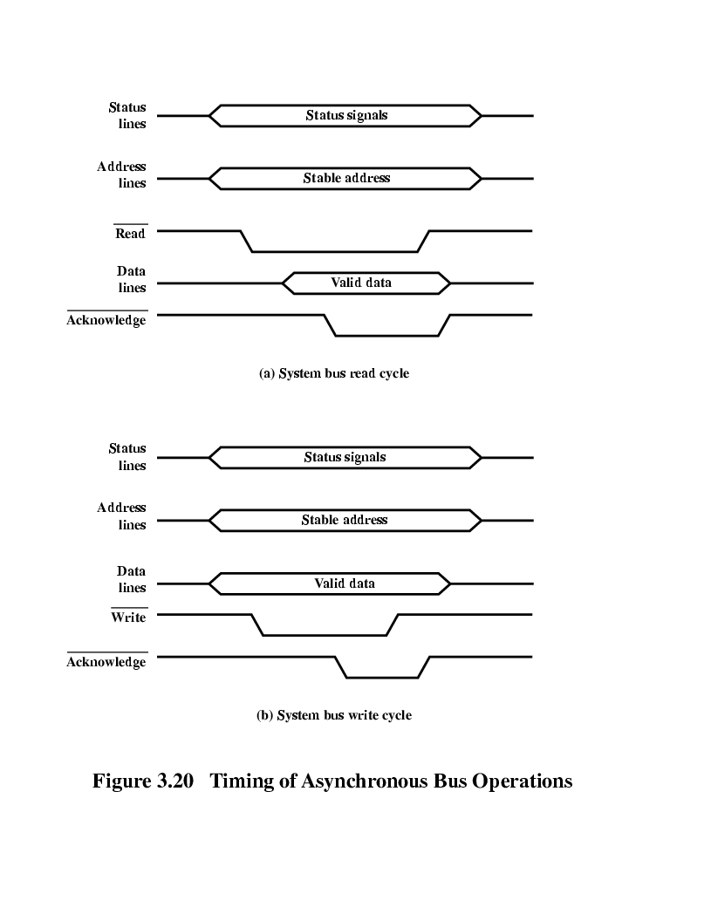
Asynchronous Timing – Read Diagram

Slide 50
Asynchronous Timing – Write Diagram

Slide 51
PCI Bus
Peripheral Component Interconnection
Intel released to public domain
32 or 64 bit
50 lines

Slide 52
PCI Bus Lines (required)
Systems lines
  Including clock and reset
Address & Data
  32 time mux lines for address/data
  Interrupt & validate lines
Interface Control
Arbitration
  Not shared
  Direct connection to PCI bus arbiter
Error lines

Slide 53
PCI Bus Lines (Optional)
Interrupt lines
  Not shared
Cache support
64-bit Bus Extension
  Additional 32 lines
  Time multiplexed
  2 lines to enable devices to agree to use 64-bit transfer
JTAG/Boundary Scan
  For testing procedures

Slide 54
PCI Commands
Transaction between initiator (master) and target
Master claims bus
Determine type of transaction
  e.g. I/O read/write
Address phase
One or more data phases

Slide 55
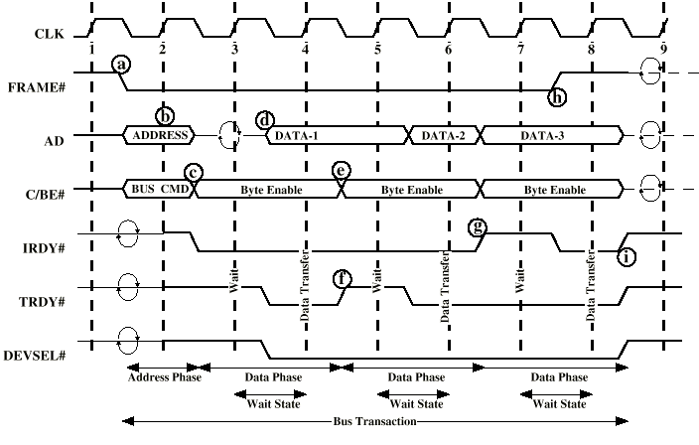
PCI Read Timing Diagram

Slide 56
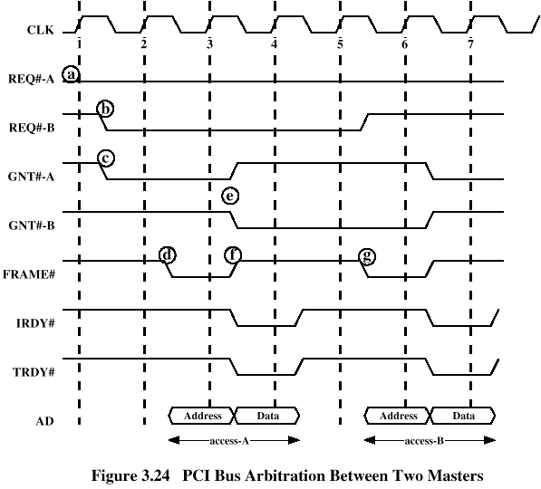
PCI Bus Arbitration

Slide 57
Foreground Reading
Stallings, chapter 3 (all of it)
www.pcguide.com/ref/mbsys/buses/
In fact, read the whole site!
www.pcguide.com/

